Slide 1
Violence and War
Name
Institution
Date

Slide 2
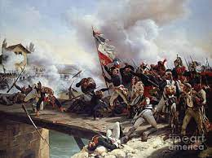
Violence and War
War refers to an intense conflict between parties
The characteristics of war include destruction, violence, and mortality
Violence involves using physical force or power
Violence causes injury, harm, and even death (Pötzsch, 2017)
Notes:
For this week's video blog, I have decided to address ethical issues in violence and war. War is defined as an intense conflict between parties such as militias, governments, and societies. The characteristics of war include violence, massive destruction, the killing of people, and aggression. While some researchers of war regard conflict to be both a widespread and ancestral component of human nature, others contend that it is the product of unique socio-cultural, economic, or ecological factors (Pötzsch, 2017). Violence involves using force with the intention of injuring or destroying. Violence may also result in psychological suffering or even death.

Slide 3
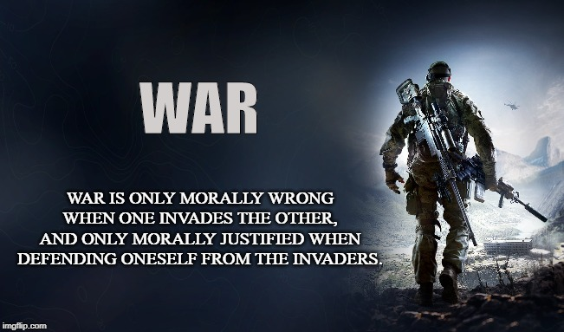
Ethical Dilemma
Killing is morally wrong
Killing deprives humans of their right to life
However, there are circumstances that justify a war to be ethical
These include in just cause, and in case it is the last resort (Shesterinina, 2019)
Notes:
The ethical issue in war and violence is that they involve killing, which is morally wrong. Morally, killing is wrong because it involves taking away life. Naturally, humans have the right to rights that should not be taken away or violated. Ethical issues in war and violence also arise in the means used in war and violent situations. In most cases, war and violence involve inhumane actions like destruction, harming, and injury. Despite war and violence being immoral and unethical, there are certain circumstances under which they can be ethically justified. Such circumstances include just cause, and in case of war is the last resort (Shesterinina, 2019). However, it is not easy to establish a just cause because some nations recognize self-defense, and nations are legally authorized to defend themselves. Another ethical dilemma arises whereby even if war is used as a last resort, it could cause more harm and suffering to innocent people.

Slide 4
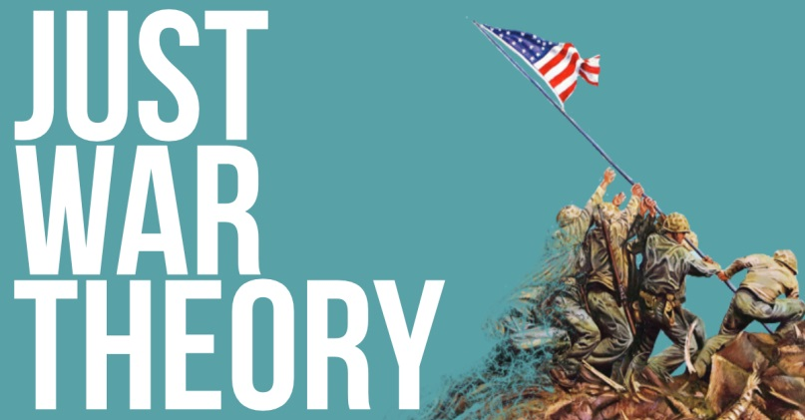
Ethical Concept
The ethical theory related to war and violence is the just war theory
The purpose of this theory is to justify the morality of war
The theory holds that war is not the only worst choice
War may be justified by undesirable impacts and essential obligations (Lazar, 2017)
Notes:
One of the ethical concepts related to war and violence is the just war theory. The purpose of the just war theory is to justify war morally through several criteria. These criteria are divided into two; the right to go to war and the right to conduct in war. The right to go to war is concerned with the morality of engaging in any war event, while the right conduct in war is concerned with moral conduct while in war (Lazar, 2017). The just war theory is based on the assertion that despite its horrors, war is not the only worst alternative. War may be justified by essential obligations, undesired impacts, and horrors that can be prevented. For a war to be ethically based on this theory, it must be a just cause, last resort, and proportional. The principles that govern the conduct in the war include discrimination and proportionality.

Slide 5
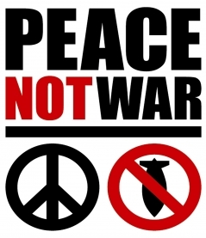
Recommendations
Consider other alternatives
One of these alternatives is pacifism
Pacifism opposes war and violence
Pacifism advocates for peaceful resolution of conflict (Jackson, 2019)
Notes:
I think instead of people engaging in war and violence, they should consider other alternatives to resolve their disputes. One of such alternatives is pacifism. Pacifism opposes war and violence and instead, advocates for the resolution of disputes using peaceful means, abolishing war and military institutions, rejects applying physical violence and force for social, political, or economic benefits, and rejects the use of violence in any circumstance (Jackson, 2019). Pacifism is supported by both consequentialist and deontological ethical concepts. In addition, pacifism holds that war is morally wrong.

Slide 6
References
Jackson, R. (2019). Pacifism and the ethical imagination in IR. International Politics, 56(2), 212-227.
Lazar, S. (2017). Just war theory: Revisionists versus traditionalists. Annual Review of Political Science, 20, 37-54.
Pötzsch, H. (2017). Selective realism: Filtering experiences of war and violence in first-and third-person shooters. Games and culture, 12(2), 156-178.
Shesterinina, A. (2019). Ethics, empathy, and fear in research on violent conflict. Journal of Peace Research, 56(2), 190-202.

